Slide 1
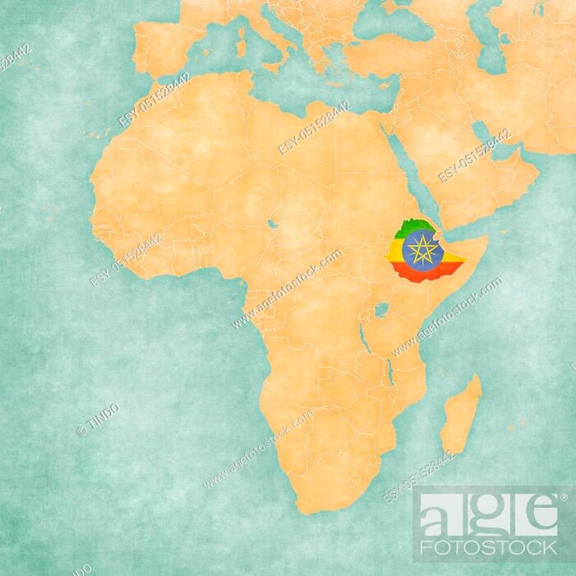
Climate, Conflict and Poverty in Ethiopia
Sri Ramesh
MDP Candidate, Development Practice Graduate Group
Rausser College of Natural Resources
Notes:
Hi everyone, I am a Master of Development Practice student at the Rausser College of Natural Resources, where I study information science and public policy. My project is on mapping the triple threat challenge of climate, conflict and poverty in Ethiopia

Slide 2
Climate change, poverty, and conflict is a triple-threat in developing nations
Number of people suffering from climate change, poverty, and conflict simultaneously is increasing
Research shows a link between weather and war (rising global temperatures leading to humanitarian conflict)
War also hits the poor the hardest
Notes:
I’ve always been interested in how war disproportionately affects the poor, and more recently in the research linking rising global temperatures to conflict.

Slide 3
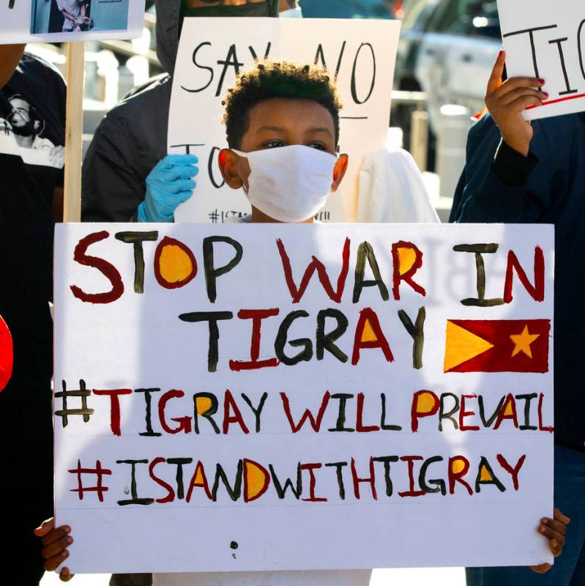
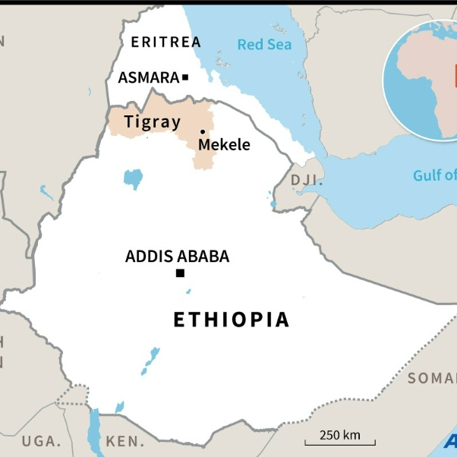
Source: Las Vegas Review Journal
Source: TIME magazine
Notes:
I chose ETH because of what’s going on in Tigray right now, a district in northern Ethiopia that borders Eritera, a country that has been at war with Ethiopia for the last few decades. As of today 20,000 Ethiopian refugees have fled Tigray for Sudan to escape the infighting between the military and an armed Tigray nationalist group known as the TPLF

Slide 4
Research question: Which populations are suffering from climate change, poverty, and conflict at the same time?
Notes:
So the research shows that like many countries, Ethiopia is seeing more and more people being simultaneously affected by the triple threat of climate change, poverty and war. My goal is to identify these districts using web maps and spatial data analysis

Slide 5
Final output: A web map of Ethiopian districts that rank high on all three indices
Climate change severity (measured by a ‘Climate Vulnerability Index’)
Poverty (measured by the Multidimensional Poverty Index)
Conflict severity (measured by the number of fatalities per 100,000)
Notes:
My final product will be a web map showing which Ethiopian districts rank high on climate change severity, poverty, and conflict severity, and for the rest of my presentation I’ll explain the methodlogy I have used to map each one

Slide 6
1. Generating a type of climate vulnerability index using map algebra
NASA STRM
Digital Elevation Model for Ethiopia, 2.5 m res
World Climate data rasters (worldclim.org)
Precipitation (i.e. rainfall), 2.5 m, 1970-2000
Average temperature, 2.5 m, 1970-2000
Cropped and masked to ETH Adm 0
Formulaically combine rasters to generate an index
Aggregate index to district level
Notes:
For climate change severity, I combined the Digital Elevation Model or DEM for Ethiopia with a 30-year historical precipitation and temperature data record from the World Climate database. I used map algebra to come do this, namely a weighted average formula that combines these values to produce a summary score. My plan is to aggregate these values to the Admin 2 level or districts in Ethiopia.

Slide 7
Current formula: Weighted average of these three rasters (after cropping, masking and resampling rasters using bilinear interpolation to the lowest resolution raster which was elevation)
Notes:
These are the DEMs and climatological rasters for Ethiopia. The temperature and precipitation rasters are from July, which is in the middle of Ethiopia’s rainy season. The current formula I used to combine these rasters was a simple weighted average. However, I’m uncertain about how to treat elevation in the formula and that’s one thing I’d love feedback on.

Slide 8
Notes:
This is the output of that formulaic combination so far, mostly for illustrative purposes. You can see this looks a lot like the DEM because values are heavily influenced by the elevation data

Slide 9

Areas of feedback re: map algebra
Treating elevation in the formula (masking DEM raster to < 5 m., etc?)
Formula itself: Weighted average formula vs. additive, multiplicative, logarithmic etc.?
Will likely aggregate by mean index values at the district level
Notes:
For feedback, I’d love to her any ideas on developing a crude measure of climate vulnerability. Especially how to treat the elevation data in the formula, and the operations I could use to combine the rasters

Slide 10
1. Mapping district-level poverty to visually see trends
University of Oxford Poverty and Human Development Initiative (OPHI) via Humanitarian Data Exchange (data.humdata.org)
2020 Multidimensional Poverty Index (MPI)
Notes:
The second component of the project in poverty, and for this I simply made a district level chloropeth map of poverty in Ethiopia. I used the 2020 multidimensional poverty index put together by the OPHI, Oxford Poverty and Human Development Initial (OPHI), which I found using HDX, the humanitarian data exchange

Slide 11
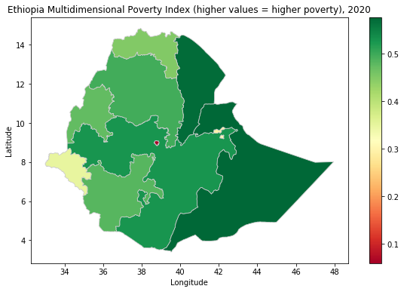
We see higher poverty in climate-vulnerable districts
Higher poverty in eastern Somali district, where there is frequent catastrophic flooding each year
Higher poverty in nothern Afar district, where average temperatures are higher
Notes:
We see higher poverty in climate vulnerable districts,. For example in the eastern somali region there is severe seasonal flooding each year from Apr – Sep. In the Northern Afar district we also see higher average temperatures. This is roughly speaking the finalized map for this portion of the project

Slide 12
1. Mapping district-level conflict to visually see trends
Armed Conflict Location Event Database (ACLED)
5,636 observations of armed and non-armed political violence in Ethiopia from 1997-2020
Attribute of interest: number of fatalities per event
Time frame: 1997-2020
Notes:
Finally, I mapped the last component, conflict using the Armed Conflict Location Event Database or ACLED. This database provides the locations of about 6,000 political violence events that have taken place in Ethiopia from 1997 to 2020.

Slide 13
More conflict events in Addis Ababa, Dire Dawa, Harari and Oromia districts
Notes:
Here is that map of the point data. What we see here is more conflict events in the center and eastern regions of the Ethiopia. And as a result, we might also expect to see more fatalities here as well

Slide 14
Counting points in polygons to measure conflict severity
Will calculate metrics ‘fatalities per 100,000 people’ by counting points in polygons
5,636 observations of armed and non-armed conflict in ETH from 1997-2020
Count events in each ETH Adm 2 polygon, sum fatalities within polygon, divide by district population and multiply resulting value by 100,000
Notes:
The ACLED data also has an attribute called number of fatalities per event. This is what I will use to measure conflict severity, which I will define as the number of fatalities by 100,000 people. Specifically, I will count points in polygons to aggregate the number of fatalities in a given district. Then, I will use district-level population statistics to calculate the number of fatalities by 100,000. The final output of this will be a district level chorlopeth of this metric.

Slide 15
COVID-19 cases per 100,000 (as of Oct 29, 2020) Source: Humanitarian Data Exchange, OCHA Ethiopia
Notes:
Finally, if we have time, I wanted to share 3 maps of covariates I considered but didn’t use. This is a chloropeth map of COVID cases per 100,000 with data from the HDX database. Here, we see the highest caseload in the center where Addis Ababa is, and in a small district in the east called Dire Dawa.

Slide 16
Location of health sites, 2020 Source: Humanitarian Data Exchange (HDX), OCHA Ethiopia
Notes:
This is a map of health sites across the country as of 2020. There’s obviously more in the central urban area where Addis is.

Slide 17
Location of refugee camps, 2020 Source: Humanitarian Data Exchange, OCHA Ethiopia
Notes:
Finally, these are refugee camp sites. There seem to be many are near the border with Eritrea in the North, and South Sudan in the east

